Slide 1

Business Data Management - Capstone Project
Optimizing Retail Efficiency: A Data-Driven Approach for LAXMI GENERAL STORE
Presented by Pammi Tiwari

Slide 2
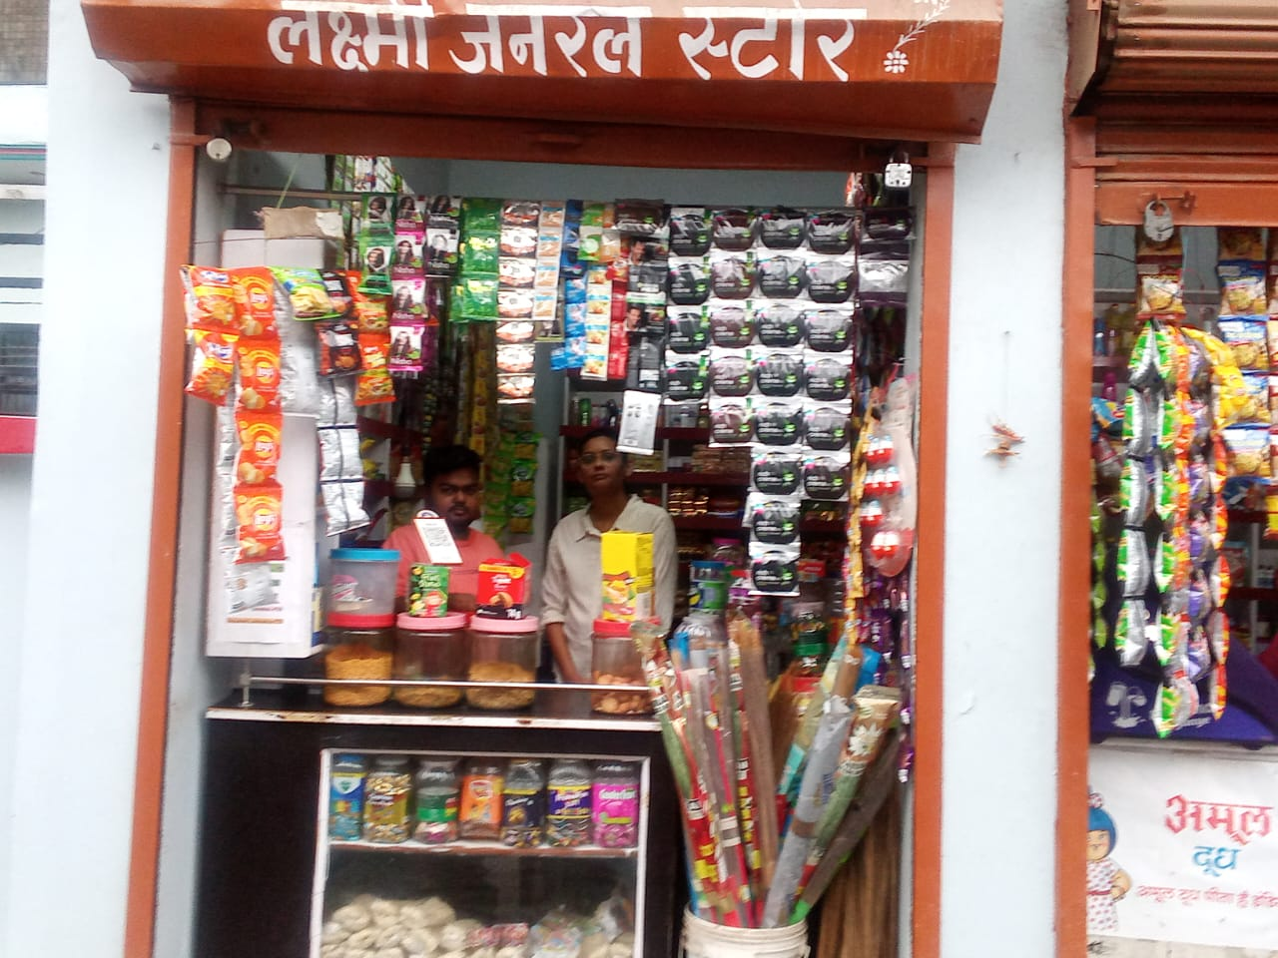
Organization Background
Name of the organisation: Laxmi General Store
Location: Preetam Nagar,Prayagraj
Established : 2021
Owner: Shivam Bhartiya
Brief Background : Laxmi General Store is a neighborhood grocery store located in Preetam Nagar, Prayagraj. Established in 2021 by Shivam Bhartiya, the store has become a trusted source for everyday household needs. It operates within the B2C sector, directly serving the local community with a wide variety of products. The store's inventory includes groceries, fresh produce, packaged foods, household essentials, and personal care items. Laxmi General Store prides itself on offering high-quality products at affordable prices, ensuring that customers receive value for their money. The store is well-known for its friendly customer service and its commitment to meeting the needs of the residents in the area. Despite its success, the store faces challenges with inventory management, which affects its profitability and customer satisfaction. By addressing these issues, Laxmi General Store aims to improve its operations and continue to serve the community effectively.

Slide 3
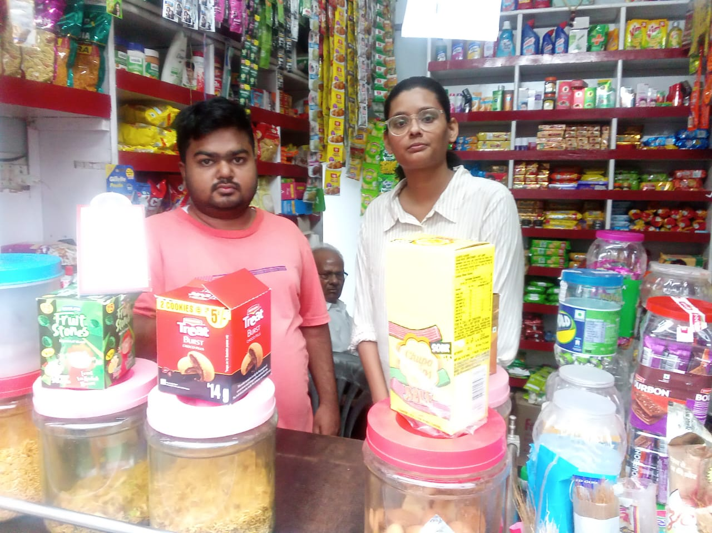
Data Collection
Introduced the project objectives and approach to the business owner. Explained the significance of analysing stock data for informed decision-making.
• Obtained explicit permission from the business owner to access and analyse relevant data.
• Sales and Purchase records from March 2024 to April 2024.
• Leveraged bills for the past 3 months to construct a foundational dataset.
• Implemented measures to protect the confidentiality and security of the collected data. Assured the business owner that data privacy and security were top priorities.

Slide 4
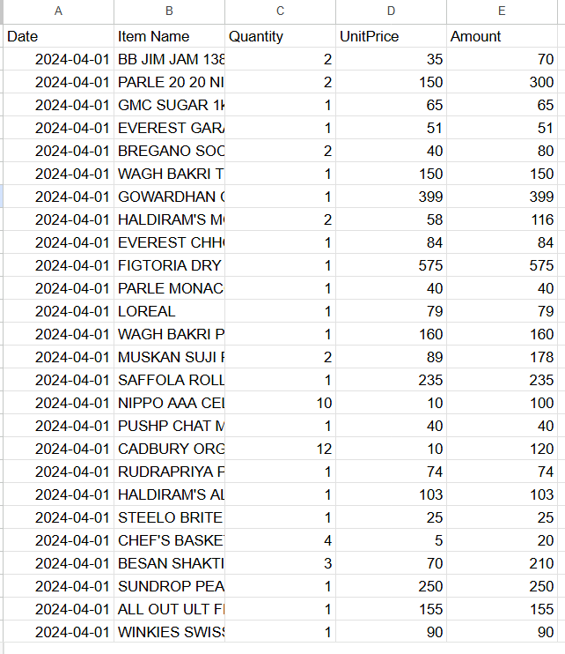
Metadata
Date (Data Type: Date/Datetime) Represents the date when the transaction occurred. It is formatted as YYYY-MM-DD.
Item Name (Data Type: Text/String) The name or description of the product/item involved in the transaction. It contains alphanumeric characters and spaces.
Quantity (Data Type: Integer) The quantity of the item sold or recorded in the transaction. It is a whole number.
Unit Price (Data Type: Float/Decimal) The price per unit of the item, represented as a decimal number.
Amount (Data Type: Float/Decimal) The total amount for the transaction, calculated as Quantity × Unit Price, represented as a decimal number.

Slide 5
About the Project
Objective of the project: To identity the problem faced by laxmi general store and help them by giving meaningful suggestions
Business Problems:
1. Problem: Unclear Spending Patterns
Difficulty in identifying customer spending trends and behaviors, leading to inefficiencies in inventory management, marketing strategies, and overall resource allocation.
2. Problem: Frequent Stockouts of Popular Items
Regular shortages of high-demand products disrupt customer satisfaction, leading to lost sales opportunities and potential damage to brand reputation.
3. Problem: Ineffective Budget Allocation
Misalignment of budget distribution across departments and products, resulting in underfunding critical areas and overspending on low-priority ones, ultimately impacting profitability.

Slide 6
Analysis
Step 1: Data Collection
What we did:
Talked to the owner and staff to understand the problems they were facing.
Collected sales data for three months (1 March 2024 – 30 May 2024) to understand the problem in detail.
Purpose: This ensured that we had sufficient context and a reliable dataset to analyze.
Step 2: Data Cleaning
Key Actions Taken:
Standardization:
Renamed columns for consistency and cleaned product names (e.g., stripping whitespace, converting to title case).
Handling Missing Values:
Recalculated missing values in key fields (e.g., Quantity and Unit Price) using available data, such as calculating "Amount" based on known fields.
Data Type Conversion:
Converted Date fields to datetime format for accurate time-based analysis.
Ensured numeric fields (e.g., Quantity, Unit Price, and Amount) were correctly formatted.
Purpose: These steps ensured a clean and consistent dataset for accurate analysis.
Step 3: Analysis
Used Python libraries to:
Plot graphs and uncover patterns in sales data.
Identify high-selling and low-performing products.
Calculate reorder points for top-selling products to ensure stock availability.
Tools Used: Microsoft Excel, Python Libraries (Pandas, NumPy, Matplotlib, Seaborn)

Slide 7
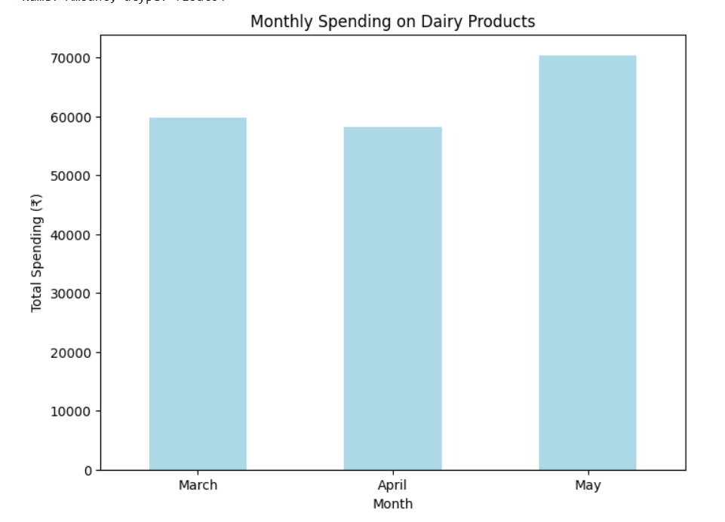
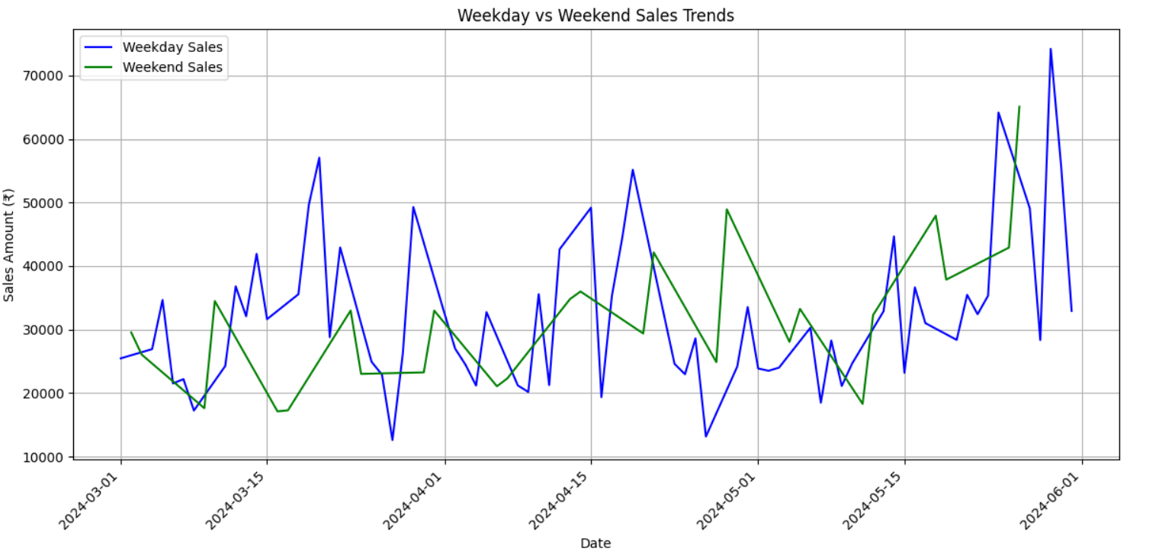
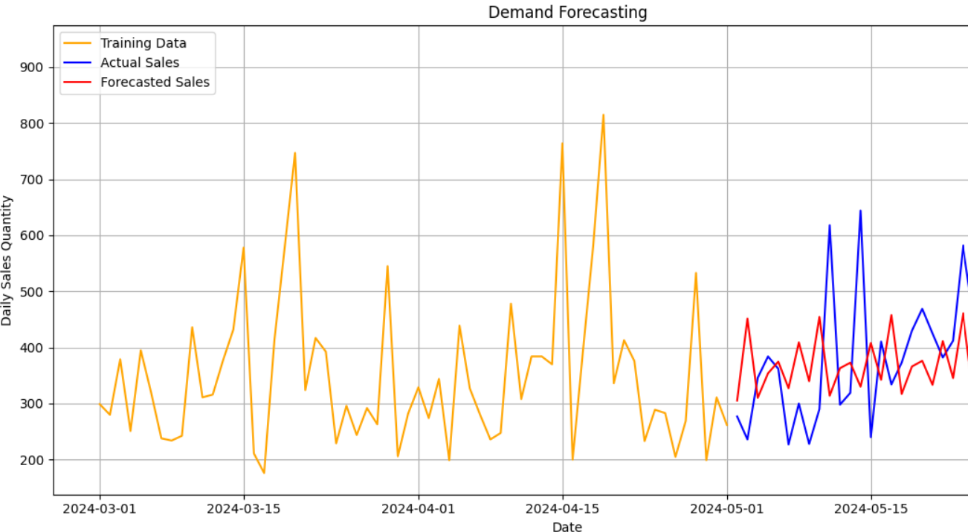
Problem 1 : Unclear Spending Patterns
Graph Explanation
1. Monthly Spending on Dairy Products (Bar Graph - Top Left)
Displays total monthly spending on dairy products for March, April, and May.
Observation: Spending increases progressively, with May showing the highest spending.
Insight: Indicates seasonal or trend-based growth in demand.
2. Weekly vs. Weekend Sales Trends (Line Graph - Top Right)
Compares sales on weekdays and weekends.
Observation: Weekends generally show higher sales spikes compared to weekdays.
Insight: Helps plan promotions and inventory management for peak periods.
3. Demand Forecasting (Line Graph - Bottom)
Shows training data, actual sales, and forecasted sales.
Observation: The model captures sales peaks and troughs, with high accuracy in predicting future trends.
Insight: Aids in proactive planning to meet demand and avoid overstocking or stockouts.

Slide 8
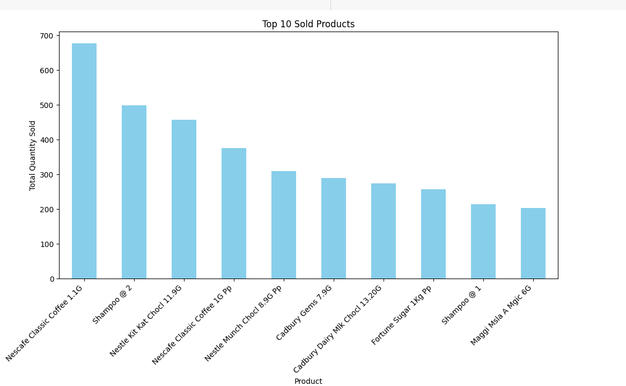
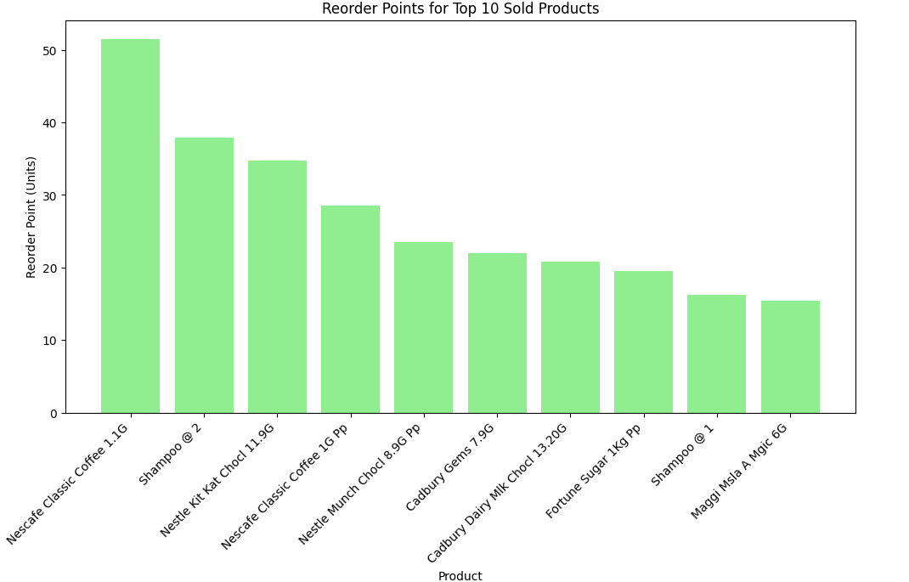
Problem 2: Frequent Stockouts of Popular Items
key insights:
Top-Selling Products: These are the most frequently sold products, including items like Nescafe Classic Coffee 110g and Shampoo S 3. They are critical to overall sales and require priority in inventory management.
What is reorder point:
A Reorder Point (ROP) is the inventory level at which a new order should be placed to replenish stock before it runs out. It ensures that you always have enough stock to meet customer demand during the lead time (the time it takes to receive the order).
Reorder Point (ROP)=(Average Daily Usage×Lead Time)+Safety Stock
Reorder Point Analysis: The green bar chart highlights reorder points for these top 10 products, ensuring timely restocking to prevent stockouts. Focusing on these frequently sold products helps maintain consistent availability and maximizes revenue.

Slide 9
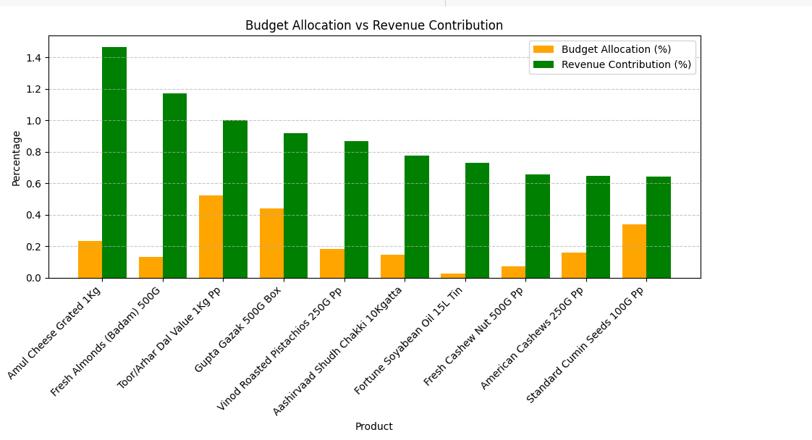
Problem 3: Ineffective Budget Allocation
Key Observations:
Under-Invested High Performers:
AMUL CHEESE GRATED 1kg:
Budget Allocation: 0.23%
Revenue Contribution: 1.47%
Insight: This product generates significant revenue compared to its small budget allocation, indicating potential for higher profitability if the investment is increased.
FRESH ALMONDS (BADAM) 500g:
Budget Allocation: 0.13%
Revenue Contribution: 1.17%
Insight: Another strong revenue generator that is under-invested. Increasing its budget allocation could further boost sales.
Balanced Products:
TOOR/ARHAR DAL VALUE 1kg PP:
Budget Allocation: 0.52%
Revenue Contribution: 1.00%
Insight: This product has a reasonably aligned budget allocation and revenue contribution, indicating efficient investment.
Opportunities for Adjustment:
GUPTA GAZAK 500g BOX:
Budget Allocation: 0.44%
Revenue Contribution: 0.92%
Insight: Moderate misalignment; increasing the budget slightly could improve returns.
VINOD ROASTED PISTACHIOS 250g PP:
Budget Allocation: 0.19%
Revenue Contribution: 0.87%
Insight: This product is under-invested compared to its revenue contribution and could benefit from additional resources.

Slide 10
Suggestions
Suggestion for the problems
Problem 1: Unclear Spending Patterns
Analyze sales data regularly to identify high-demand periods and trends.
Use demand forecasting to plan inventory for high-demand products and avoid overstocking low-demand ones.
Categorize products to understand which category contributes the most to revenue and allocate budgets accordingly.
Align marketing efforts with seasonal demand trends to maximize sales during peak periods.
Problem 2: Frequent Stockouts of Popular Items
Calculate reorder points for top-selling products to ensure timely restocking: Reorder Point=(Average Daily Usage×Lead Time)+Safety Stock
Focus on maintaining inventory for critical products like coffee, sugar, and toiletries.
Collaborate with multiple suppliers to reduce lead times and avoid delays in replenishing stock.
Problem 3: Ineffective Budget Allocation
Reallocate budgets to high-revenue products like "Amul Cheese Grated 1kg" and "Fresh Almonds."
Increase investment in underfunded but high-performing products to further boost sales.
Maintain steady budget allocation for balanced products that align with their revenue contribution.
Reduce spending on low-performing products and redirect funds to high-demand items.
Additional Suggestions
Expand Product Variety
Introduce new items based on customer preferences or seasonal trends to attract more buyers.
Replace low-demand products with high-demand or trending items to optimize inventory and increase sales.
Offer Discounts and Promotions
Run discounts during slow seasons or on slow-moving stock to boost sales and clear inventory.
Bundle products to encourage customers to buy complementary items, increasing overall revenue.
Leverage Customer Feedback
Collect and use customer suggestions to improve product selection and services.
Reward loyal customers with discounts, perks, or exclusive offers to build stronger relationships.
Improve Customer Experience
Keep the store clean, well-organized, and easy to navigate to ensure a pleasant shopping experience.
Train staff to provide friendly and helpful customer service, fostering customer loyalty.
Flexible Supply Chain
Work with multiple suppliers to ensure consistent stock availability and reduce dependency on single vendors.
Negotiate shorter lead times and better prices for bulk purchases to save costs.
Build a supply chain system that quickly adapts to unexpected demand changes, ensuring the store remains well-stocked.

